Slide 1
B
Statics
Trusses and Load Analysis using Method of Joints
34⁰
A
C
LabRat Scientific
© 2018
1.0 lb

Slide 2
Related Terms
Compression: The condition where loads work to squeeze an object together.
Tension: The condition where loads work to pull an object apart.
Torsion: The condition where external forces work to twist an object.
(while this action can affect a truss member it is not
addressed in this lesson)

Slide 3
Structural Geometry
An examination of truss structures will reveal that triangles play a significant role in their design. The triangle is a very rigid and stable geometric shape:
Rectangle: Does not resist lateral forces very well.
Triangle: Is a strong and ridged shape which resists loads well.

Slide 4
Structural Geometry
When a lateral force is applied to a triangle it will retain its shape. If a lateral force is applied to the top of a square it will tend to deform.
Applied Force
Applied Force
Compression
Bending
Tension
Rotation

Slide 5
Notice all the triangles located throughout this bridge

Slide 6
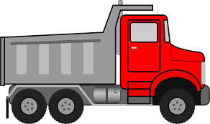
Structural Trusses
A truss is a structure made out of beams (a.k.a. members) whose purpose is to span a gap (i.e. a river). The truss supports the load and transfers it to points where is can be supported.

Slide 7
Analyzing Loads in a Truss Structure
When designing a bridge, tower, or roof system engineers need to be able to calculate the magnitude of the forces acting on the truss members and whether the members are in tension or compression.
Two Methods:
Method of Joints (focus of this lesson)
Method of Sections

Slide 8
Method of Joints
The Method of Joints is used to calculate the forces acting on the pins or ball joints that join the truss members together. The joint forces then push/pull on the truss members which then push/pull on the other joints.
When the analysis is complete all of the joint and member forces are known…

Slide 9
Method of Joints – Force Sign Convention
Y
Positive Y-Force Direction
Positive X-Force Direction
Negative X-Force Direction
Negative Y-Force Direction
X

Slide 10
Method of Joints – Compression and Tension Convention
The direction arrows are known as the “sense” of the force. The “sense” indicates whether the truss members are in compression or tension.
During the analysis we must initially assume the “sense” of the forces, but the mathematics will ultimately tell us if those assumptions were correct…
If the Beam Force Vector is pointing towards the pin joint, then the beam is in Compression.
If the Beam Force Vector is pointing away from the pin joint, then the beam is in Tension.

Slide 11
Trigonometry Review
Sin ϴ = Opp / Hyp
Cos ϴ = Adj / Hyp
Tan ϴ = Opp / Adj
Hyp
Opp = Sin ϴ₂ / Hyp
Opp² + Adj² = Hyp²
90⁰
ϴ₂
Adj = Cos ϴ₂ / Hyp

Slide 12
Sample Problem – Simple Cantilevered Truss
The Method of Joints can be used to analyze the pin and member forces in this simple cantilevered, triangular truss system.
B
18 in.
An downward 1.0 lb external force is applied to the truss at Point A.
34⁰
A
15 in.
C
The Method of Joints analyzes each connecting joint (A, B, and C) in the structure individually.
1.0 lb

Slide 13
Analysis for Point A
The 1.0 lb downward force is a given, so this makes Point A a good starting point for the analysis.
F_{AB}
We know there is a diagonal member (AB) which must apply a force to Point A to keep it in static equilibrium. We label this force F_{AB} and select its “sense”. We should realize this force needs to be pulling upwards to balance the 1.0 lb downward force…
A
F_{AC}
1.0 lb
We also know there is a horizontal member (AC) that is also applying a force to Point A. We label this force F_{AC} but the “sense” is a little more difficult to determine. As such, we make our best guess…
Free Body Diagram (FBD) for Point A.

Slide 14
Analysis for Point A
Since we have a known vertical force of 1.0 lb we should start off by analyzing the vertical forces (Y-direction). We will ignore the horizontal force for now…
F_{up}
F_{AB}
There are two vertical forces acting on Point A – the downward force and the upward force being applied by Member AB.
34⁰
F_{AC}
We need to sum the forces in the Y-direction. Since the system is assumed to be in static equilibrium, the sum of the forces must be equal to zero.
1.0 lb
∑F_{y} = 0
Free Body Diagram (FBD) for Point A.
The negative (-) sign indicates a downward force.
∑F_{y} = (+ F_{up}) + (- F_{down}) = 0

Slide 15
Analysis for Point A
The problem is, we don’t know the magnitude of the upward force…
F_{up}
34⁰
+ Sin(34) * F_{AB}
F_{AB}
However, using trigonometry we can express this upward force in terms of the force in Member AB. This force is F_{AB} .
34⁰
F_{AC}
F_{up} = + Sin(34) * F_{AB}
Inserting the “forces” into the force equation yields:
1.0 lb
∑F_{y} = (+ F_{up}) + (- F_{down}) = 0
∑F_{y} = (+ Sin(34) * F_{AB}) + (- 1 lb) = 0
We can apply a little algebra to determine the magnitude of F_{AB} …

Slide 16
Analysis for Point A
F_{up}
(+ Sin(34) * F_{AB}) + (- 1 lb) = 0
34⁰
+ Sin(34) * F_{AB}
F_{AB}
(+ 0.56 F_{AB}) = (+ 1 lb)
34⁰
F_{AB} = (+ 1 lb) / (0.56)
F_{AC}
F_{AB} = 1.8 lb
F_{AB} is ultimately what we want since it tells us the magnitude of the force in Member AB.
1.0 lb
Since the math used to generate F_{AB} results in a positive (+) value for F_{AB} the sense we selected is correct.

Slide 17
Analysis for Point A
The next step is to analyze the horizontal (X-direction) forces at Point A.
F_{AB} = 1.8 lb
In our original diagram we had already defined force F_{AC} as being generated by the horizontal Member AC. We defined (guessed?) it as a left-pointing force so it is a negative (-) force.
34⁰
F_{AC}
The diagonal Member AB is also pulling on Point A. This force is the horizontal component of F_{AB}. We already determined that F_{AB} was pointing towards the right, so the component will also point towards the right. As such, it is a positive (+) force.
1.0 lb

Slide 18
Analysis for Point A
As was done in the Y-direction, the X-direction forces are summed and set equal to zero.
F_{AB} = 1.8 lb
∑F_{x} = 0
34⁰
Inserting the forces into the force equation yields:
F_{AC}
∑F_{x} = ( + Cos (34) * F_{AB} ) + ( - F_{AC} ) = 0
+ Cos (34) * F_{AB}
Performing some simple algebra yields:
1.0 lb
( + Cos (34) * F_{AB} ) = ( + F_{AC} )
( + .83 * 1.8 lbs ) = ( + F_{AC} )
F_{AC} = 1.5 lbs

Slide 19
Analysis for Point A
F_{AC} is the force generated by the horizontal Member AC. Since the sign of F_{AC} was calculated as a positive value (+ 1.5 lbs), the “left-ward sense” that was originally selected for F_{AC} was correct…
F_{AB} = 1.8 lb
34⁰
F_{AC} = 1.5 lbs
F_{AC}
+ Cos (34) * F_{AB}
Force F_{AC} balances the right-ward force component being generated by the diagonal Member AB and thus keeps the system in static equilibrium in the X-direction.
1.0 lb

Slide 20
Analysis for Point A
Component of F_{AB} = 1.0 lb
Component of F_{AB} = 1.5 lbs
If we look at the X and Y forces acting on Point A we see that they all balance each other – indicating the system is in static equilibrium.
F_{AC}
F_{AC} = 1.5 lbs
1.0 lb

Slide 21
Forces in the Truss Members
B
By analyzing Point A we were able to determine the magnitude and correct sense of the forces in the two truss members…
F_{AB} = 1.8 lb
34⁰
A
F_{AC} = 1.5 lb
C

Slide 22
Compression and Tension State
From the vector convention defined earlier we can identify if the beams are in tension or compression.
We can use this information to design the members in the truss…
B
TENSION
1.8 lb
34⁰
A
1.5 lb
C
We now know the forces in the members, but we also need to know the reactive forces being generated by Point B and Point C…
COMPRESSION

Slide 23
Analysis for Point B
Adj = Cos (34) * 1.8 = 1.5 lb
B
From the previous calculations we can conclude that Member AB exerts a diagonal force on Point B.
This force can be broken into horizontal and vertical components.
34⁰
F_{AB} = 1.9 lb
Opp = Sin (34) * 1.8 = 1.0 lb

Slide 24
Analysis for Point B
To find the reactive forces being generated by Point B to keep the system in equilibrium we simply sum forces in the X and Y directions and set them equal to zero as was done for Point A.
F_{By}
1.5 lb
B
F_{Bx}
∑F_{x} = ( F_{Bx} ) + ( - 1.5 ) = 0
These are the forces being applied by Point B to resist the force being applied by Member AB.
1.0 lb
F_{Bx} = + 1.5 lb
∑F_{y} = (F_{By}) + (- 1.0 lb) = 0
F_{By} = + 1.0 lb

Slide 25
Analysis for Point C
1.5 lb
Horizontal force being applied by Member AC
C
F_{Cx}
∑F_{x} = ( - F_{Cx} ) + ( + 1.5 ) = 0
F_{Cx} = + 1.5 lb
This is the force being applied by Point C to resist the force being applied by Member AC.

Slide 26
The forces acting on the system
B
1.0 lb
1.5 lb
TENSION
1.8 lb
34⁰
A
1.5 lb
1.5 lb
C
1.0 lb
1.5 lb
COMPRESSION

Slide 27
But does the Method of Joints generate reliable results?
The simple truss model used in the analysis makes it fairly easy to conduct experiments to determine the actual compressive and tension forces in the truss members…

Slide 28
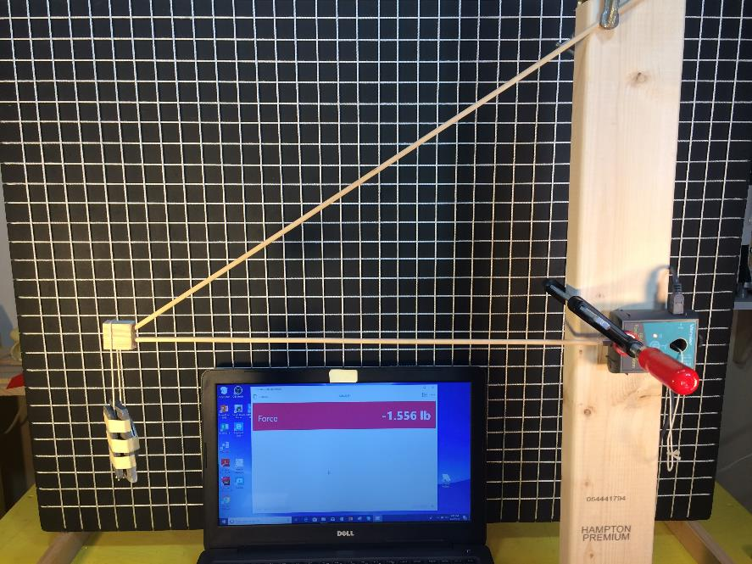
Experimental Set-up
Truss Structure
Digital Load Cell
1.0 lb Test Weight
Force Measurement

Slide 29
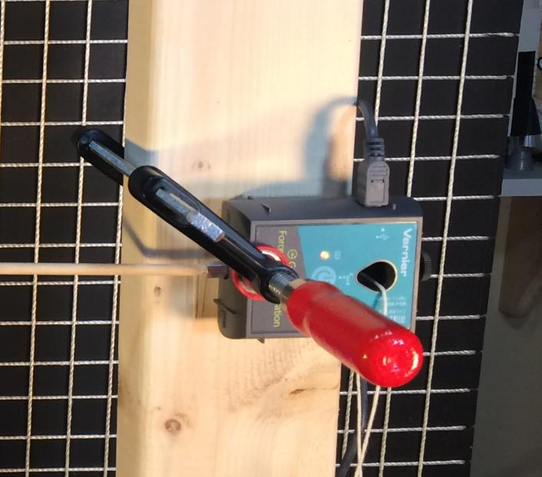
Digital Load Cell – Sign Convention
A force pushing into the load cell will produce a negative (-) force reading.
A force pulling on the load cell will produce a positive (+) force reading.

Slide 30
Experimental Verification
An experiment was conducted to verify the theoretical calculation.
The force in the horizontal member was measured to be -1.56 lbs. which is very close to the calculated theoretical value of 1.5 lbs. The negative sign on the force value displayed on the computer screen indicates the force is pushing towards the right. This is consistent with the direction determined in the analysis. This verifies that the horizontal member is under compression.
Digital Force Meter
1.0 lb Weight

Slide 31
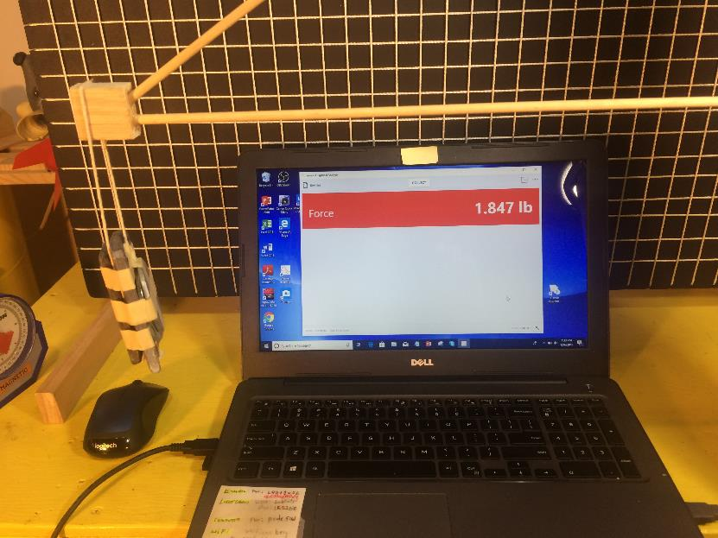
Experimental Verification
A second experiment was conducted to measure the load in the diagonal beam.
In this experiment the digital force measuring device was attached the diagonal beam. The same 1.0 lb test weight was applied to the end of the truss.
The load in the diagonal member was measured to be +1.85 lbs which is very close to the calculated theoretical value of 1.8 lbs.

Slide 32
Comparison of Results
 | Theoretical | Experimental
Member AB | 1.8 lb | 1.85
Member AC | 1.5 lb | 1.56
The experimental results were in fairly good agreement with the theoretical calculations.
The differences are well within the length and angle measurement errors.

Slide 33
Building a Balsawood Truss Bridge
The Method of Joints can be used to analyze a balsa wood bridge (maybe you have a competition in engineering class…). While you may not be deeply concerned about the actual forces at the joints (since you probably won’t go as far as calculating the strength of your glue joints), it is pretty important to determine whether the various members are in compression or tension. In general, members that are in tension can be lighter than members in compression because the members that are in tension won’t have a buckling concern. This might allow you to build the lightest and strongest bridge…
See the companion balsa-bridge classroom lesson and testing video…

Slide 34
B
Questions ?
34⁰
A
C
1.0 lb

